Slide 1


FAKE COVID NEWS DETECTION
Zaiyr Sharsheev, COM-18
CS 415: Machine Learning

Slide 2

The purpose of this project is to find out if specific news about coronavirus is true or false.📊🦠 After the outbreak of the pandemic, some media provide false news about the coronavirus for the ratings. My mission is to help people filter news and keep abreast of only true current news.

Slide 3


TOOLS AND PROGRAMMING LANGUAGE
This project is based on developing an EPL (English Premier League) Football Matches Predictions using Python Programming Language and Jupyter Notebook (an open-source web application that allows to create and share documents that contain live code, equations, visualizations and narrative text)

Slide 4
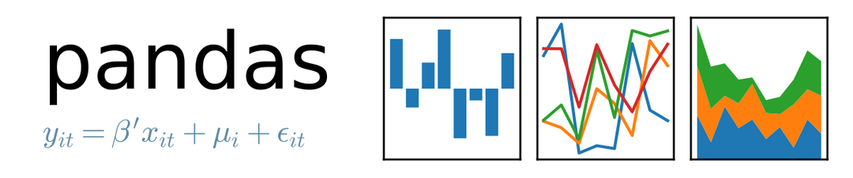

Which libraries did I use?

Slide 5
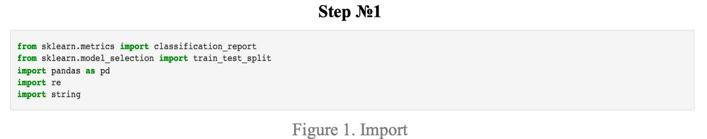
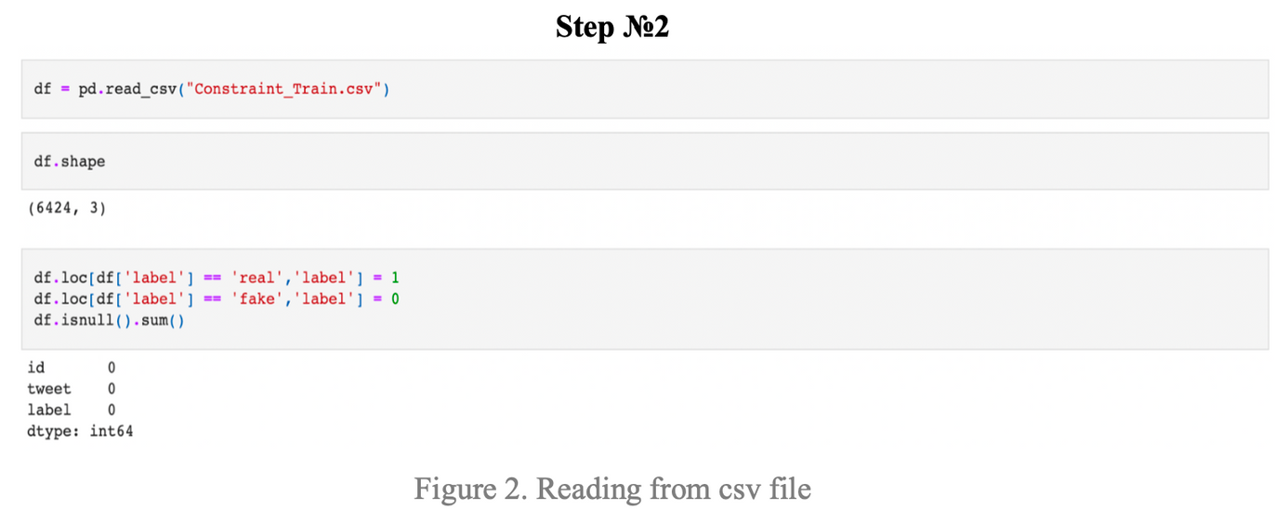
Source Code

Slide 6
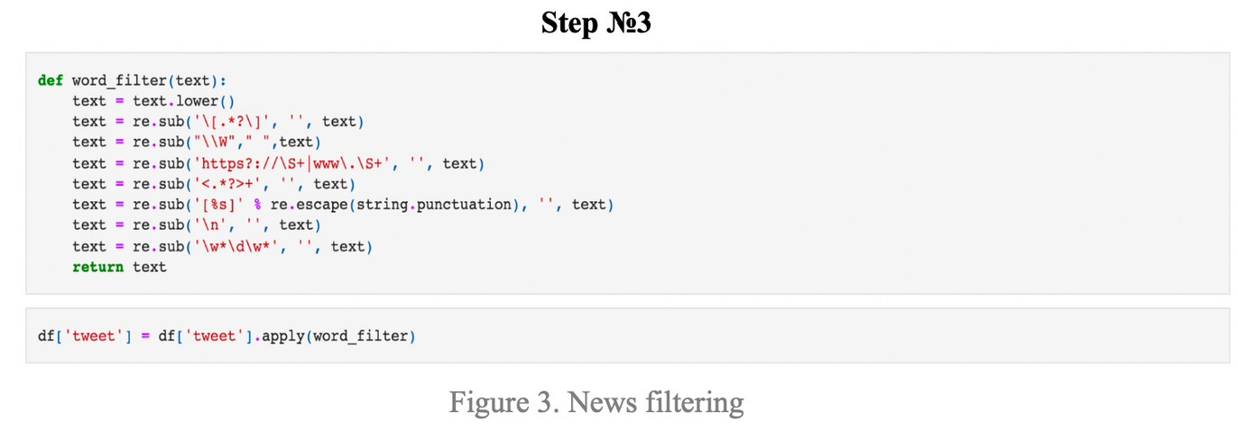
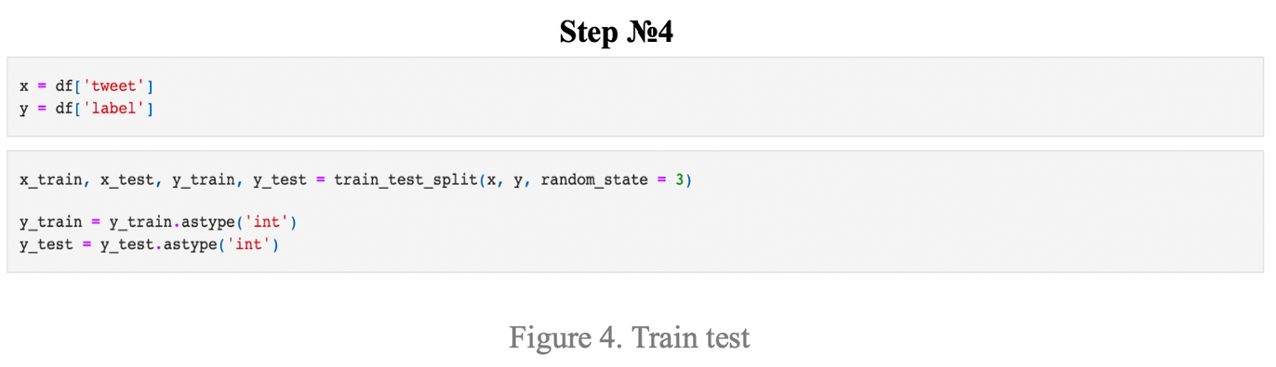
Source Code

Slide 7
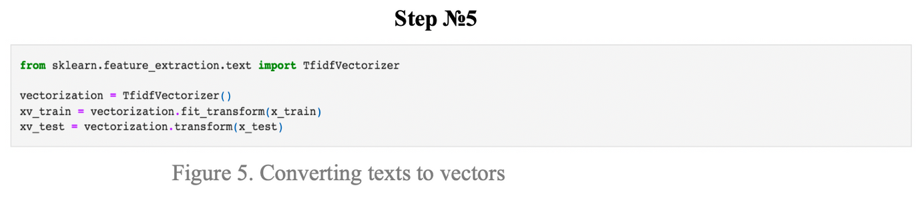
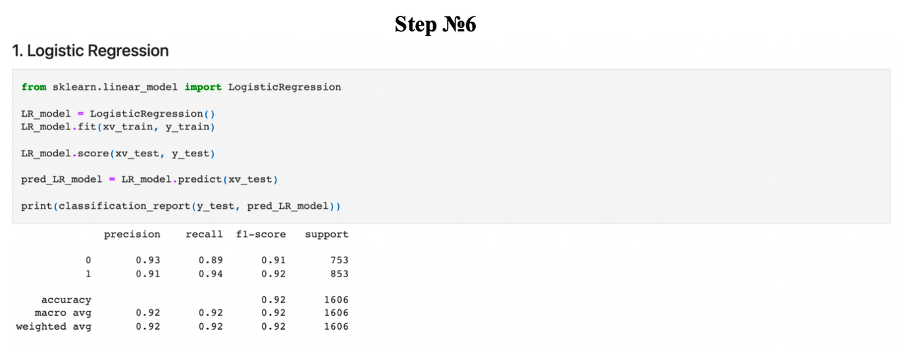
Source Code

Slide 8
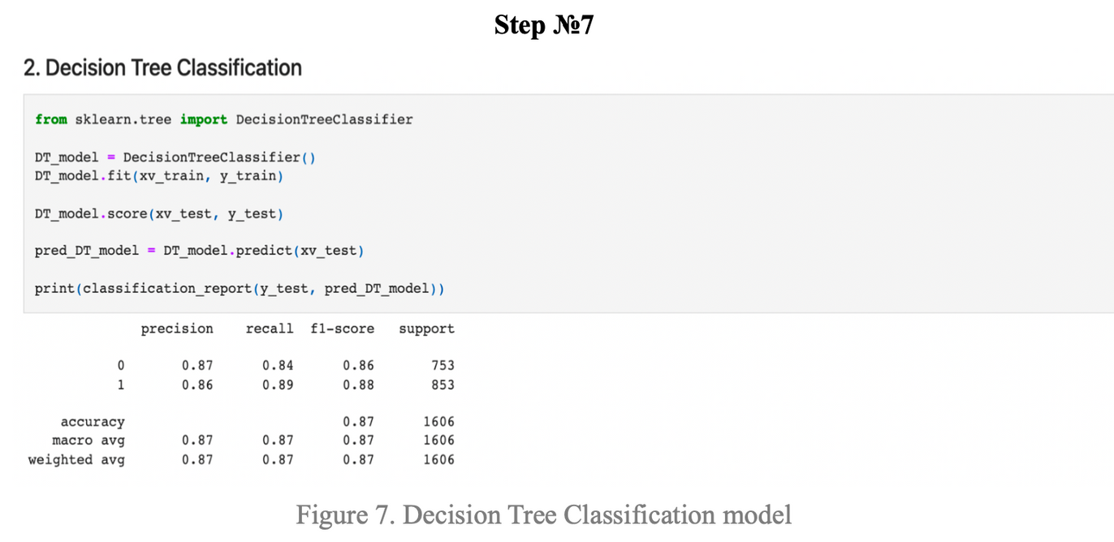
Source Code

Slide 9
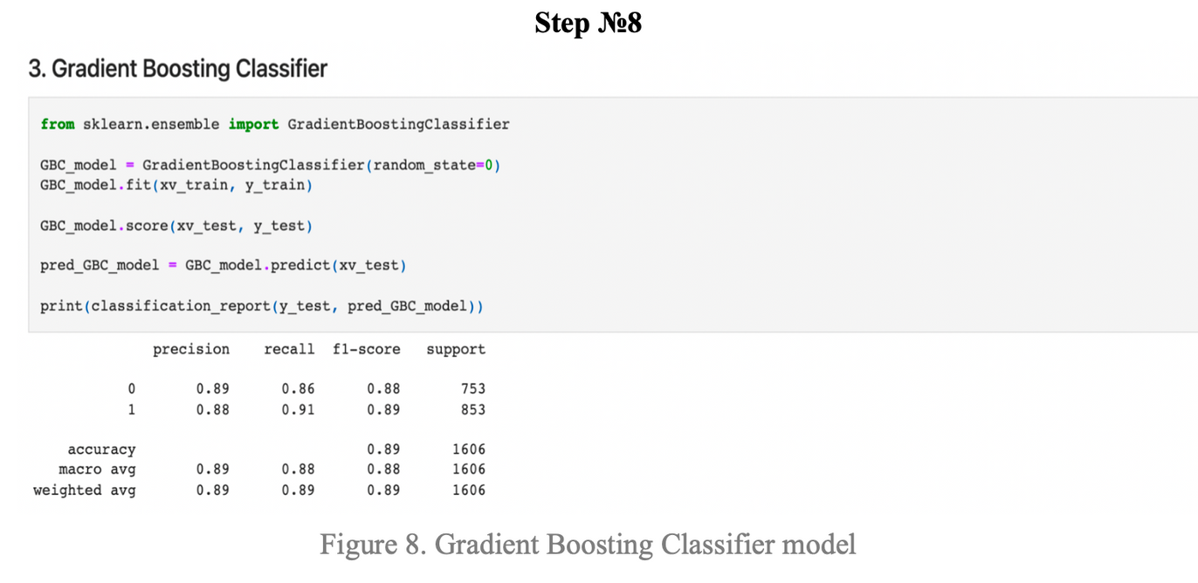
Source Code

Slide 10
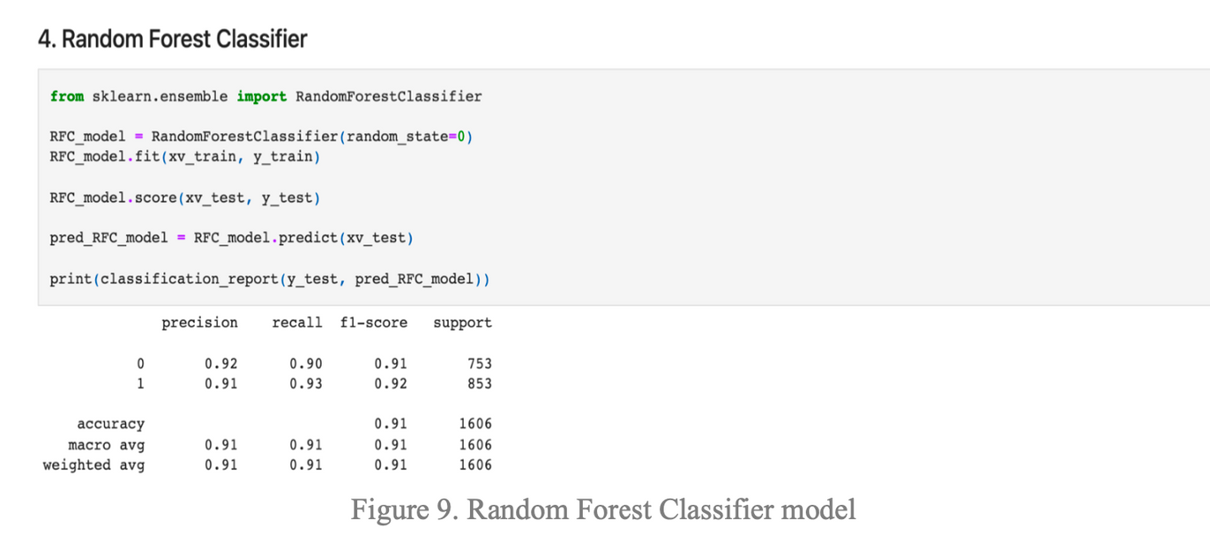
Source Code

Slide 11
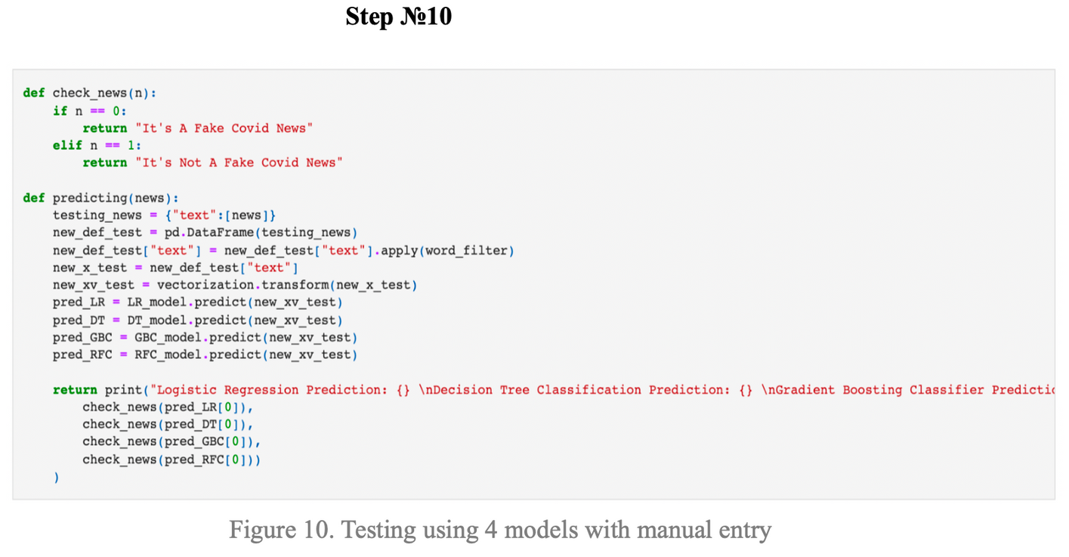
Source Code

Slide 12
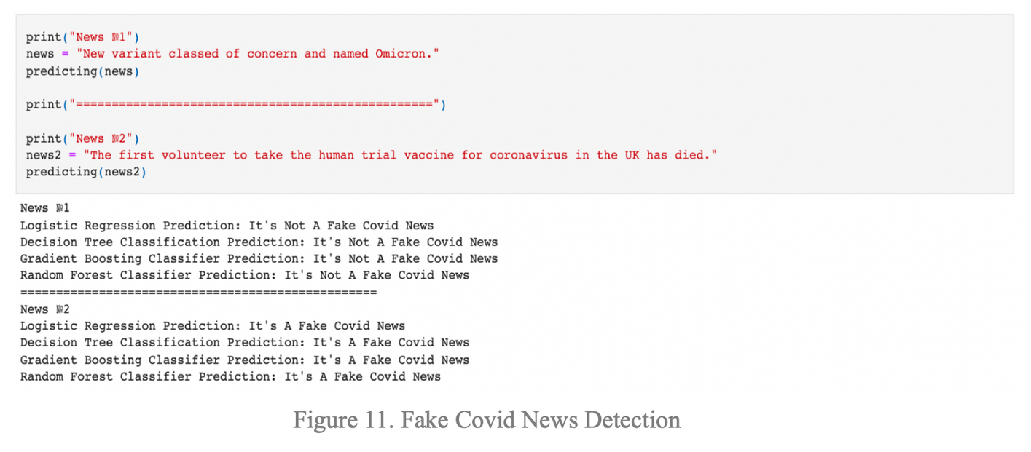
Source Code

Slide 13

THANK YOU
FOR ATTENTION
AND TAKE CARE OF YOURSELF!

